Slide 1
Visual Schedule Images
www.OFTHEHEARTH.com

Slide 2
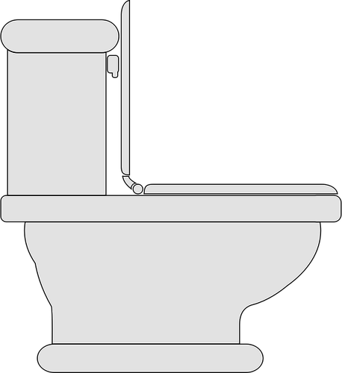
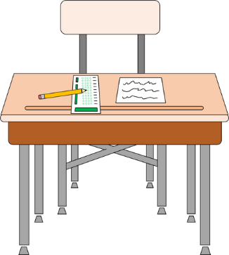
WAKE UP
USE POTTY
EAT BREAKFAST
GET DRESSED
BRUSH TEETH
COMB HAIR
DO SCHOOLWORK
GO TO LIBRARY
GO TO STORE
PLAY OUTSIDE

Slide 3
PLAY WITH TOYS
PUT TOYS AWAY
EAT LUNCH
WATCH TV
PLAY ON TABLET
LOOK AT BOOKS
EAT SNACK
PLAY WITH TOYS
DO AN ART PROJECT
PLAY OUTSIDE

Slide 4
GO ON A WALK
TAKE A BATH
EAT DINNER
PLAY WITH QUIET TOYS
BRUSH TEETH
PUT ON PAJAMAS
USE POTTY
READ BEDTIME STORY
GO TO BED
VISIT ON COMPUTER

Slide 5
GO TO CHURCH
GO TO THE DOCTOR
GO TO THE BANK
GO TO THE HOSPITAL
GO TO THE DENTIST
GO TO THE PARK
PLAY WITH FRIENDS

